Slide 1
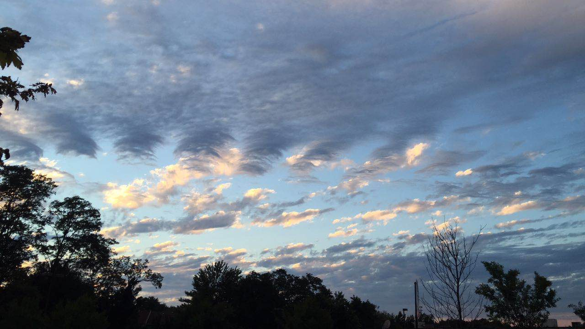




Atmospheric Gravity Waves, and how do we observe them? – Part I
Jie Gong (Jie.Gong@nasa.gov)
NASA Goddard Space Flight Center

Slide 2
How many wave trains can you see from this photo?
Photo taken out of my office @ Greenbelt, MD

Slide 3
Outlines
Introduction of gravity waves
Importance of gravity waves
Major gravity wave sources
Gravity wave propagation
Modeling of Gravity wave impact
Satellite observation of gravity waves (w/ eclipse-GW example)
Radiosonde observations of gravity waves (w/ eclipse-GW example)
Gravity wave observational window
Summary
PART I
PART II

Slide 4

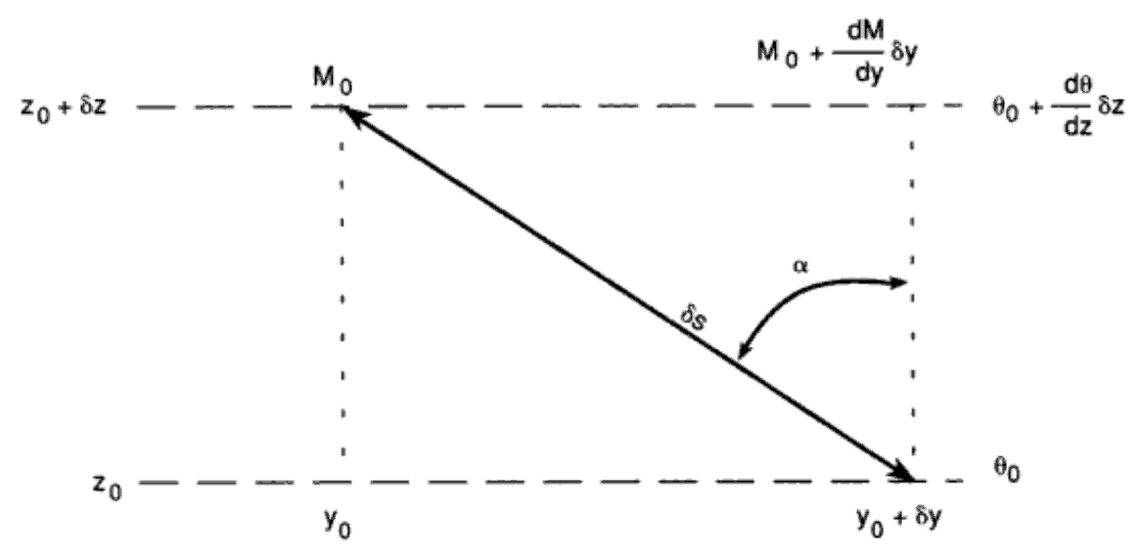
1. What are gravity waves?
Buoyancy
Waves occurring in a stably stratified fluid; buoyancy acting as the restoring force (pure internal gravity wave)
If modified by rotation, Coriolis force also acts as the restoring force (inertia-gravity wave)
Period: buoyancy oscillation period – inertial period (10min - 1day)
Horizontal wavelength: 10 – 1000s km
Vertical wavelength: 0.1 – 10s km
Gravity
Buoyancy
Coriolis force: on a rotating sphere, Coriolis force is always to the right (left) of the moving direction of a parcel in the Northern (Southern) hemisphere
Coriolis Force
(Holton, 2004, Fig. 7.11)
Gravity

Slide 5
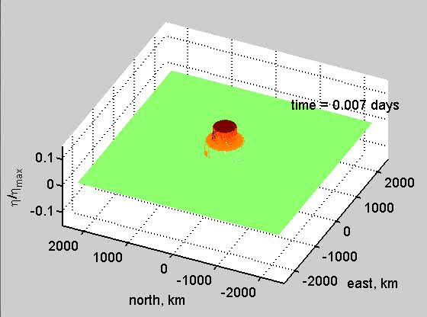
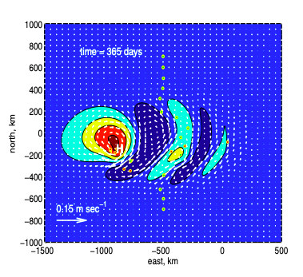
How latitudinal change of Coriolis force (called “beta-plane”) generate inertial gravity waves
Bird-eye view
https://ocw.mit.edu/courses/res-12-001-topics-in-fluid-dynamics-spring-2022/mitres_12_001_act_p3.pdf

Slide 6
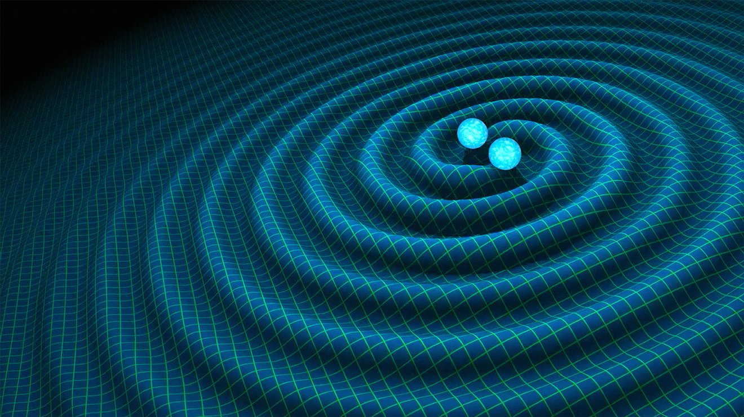
Are gravity waves the same with gravitational waves?

Slide 7
2. Why are gravity waves important?
Transport/redistribute energy and momentum from the source (often lower atmosphere) to the sink (often upper atmosphere)
Therefore, GWs play critical roles in shaping the middle atmosphere dynamics (e.g., mesosphere wind reversal, quasi-biennual oscillation)
Local effects:
Induce turbulence – important for mixing of chemical species and water vapor (e.g., clear air turbulence, polar stratospheric cloud, polar mesosphere cloud)
Modulate or initiate synoptic weather (e.g., gravity wave front)

Slide 8
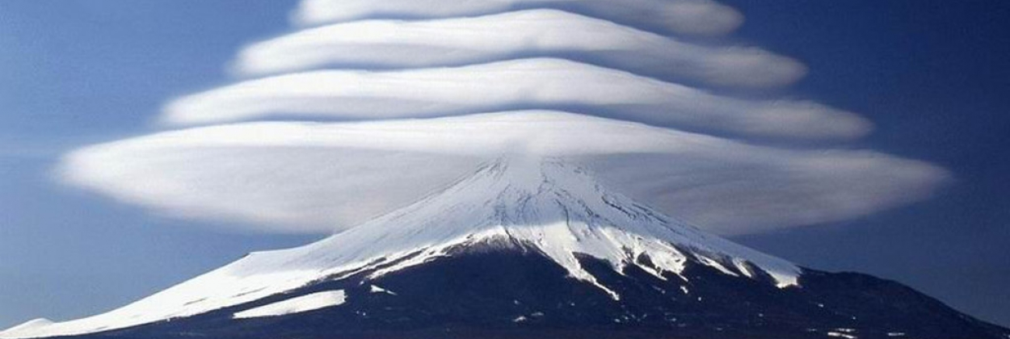
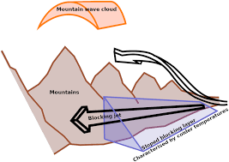
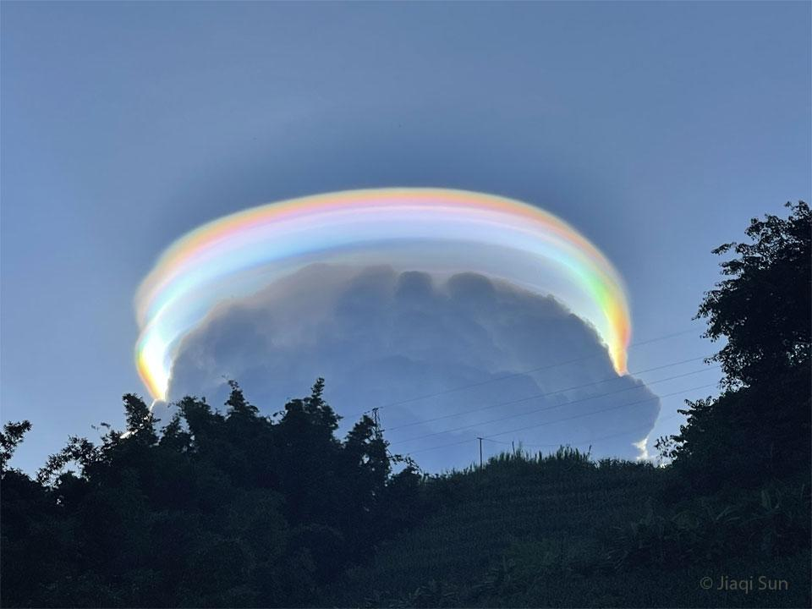
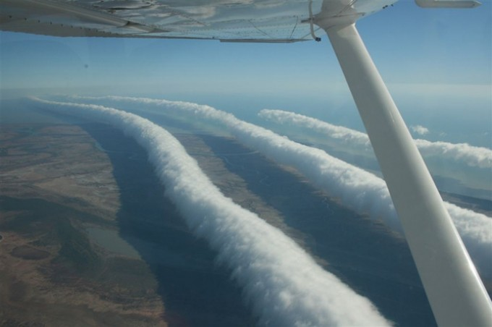
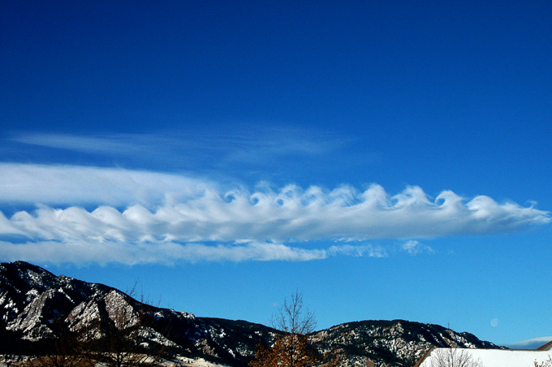
Extraordinary lenticular cloud over the Mt. Fuji
(Geldenhuys, 2022, ASL)
https://www.aerotime.aero/articles/23079-extraordinary-lenticular-clouds-mount-fuji-mountain
Pileus Cloud
Morning glory cloud
Kelvin-Helmholtz wave cloud
https://science.nasa.gov/iridescent-pileus-cloud-over-china
Photo credit: Mick Petroff
Photo credit: UCAR/NCAR

Slide 9
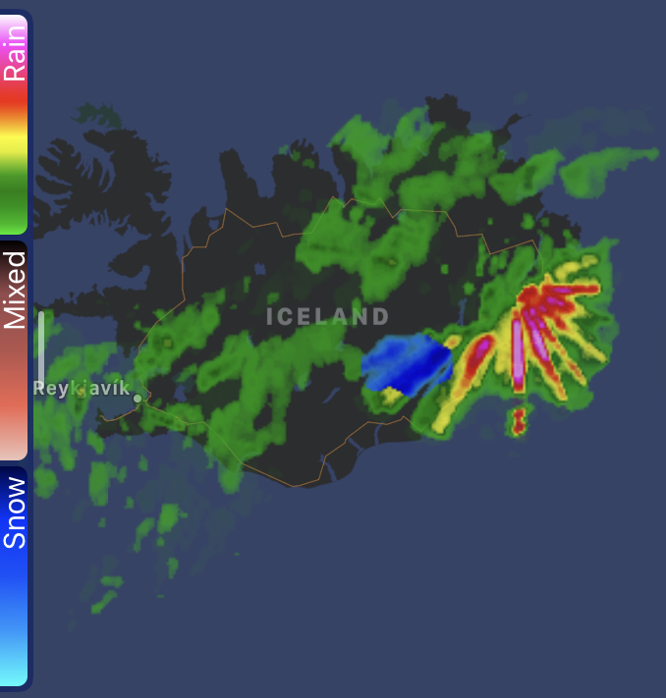
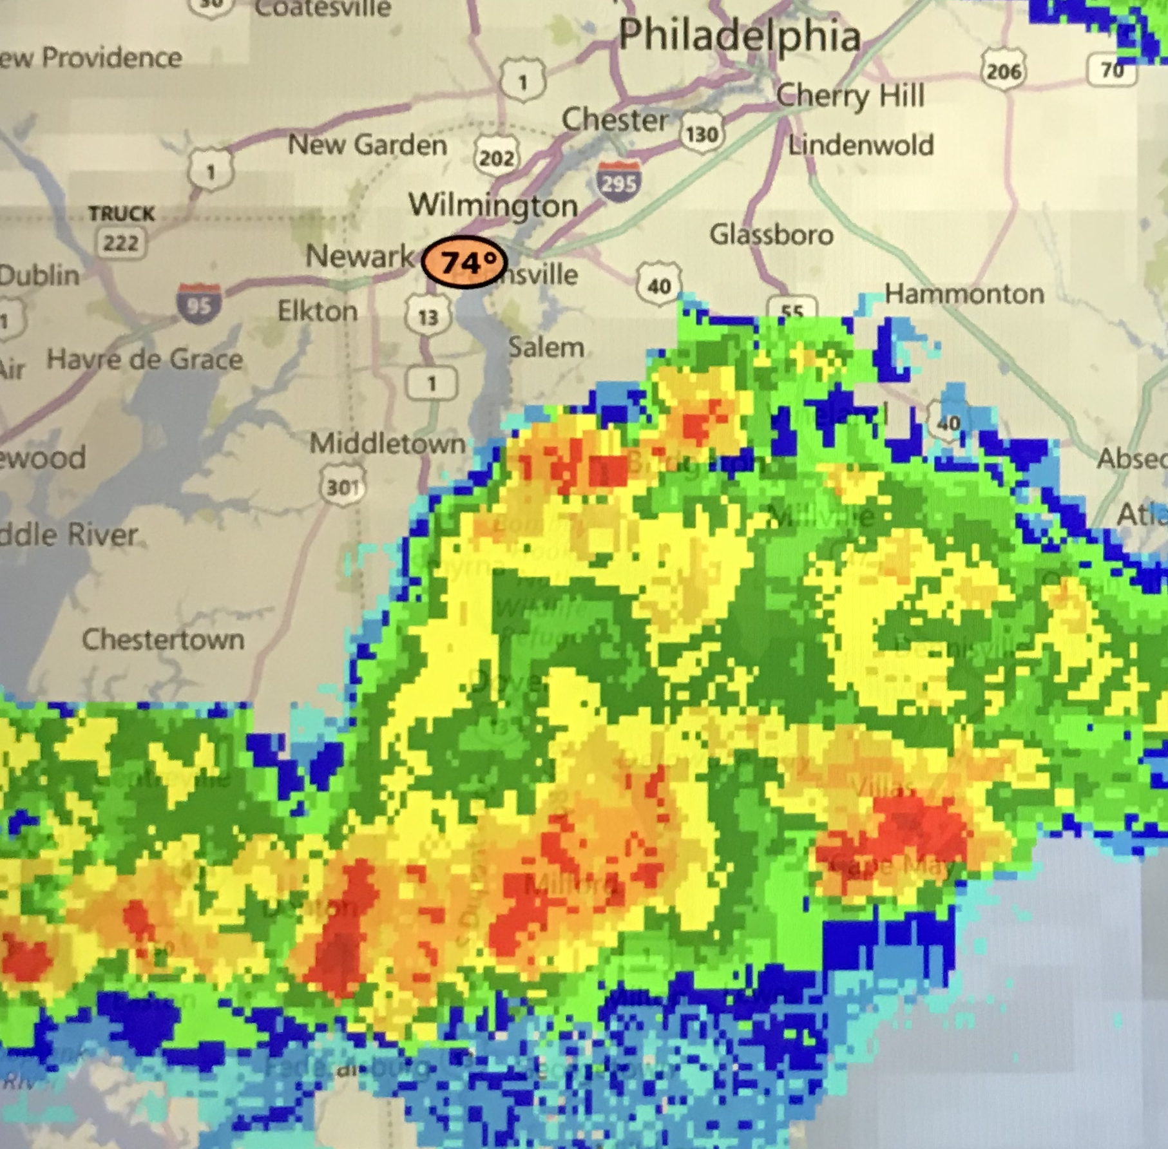
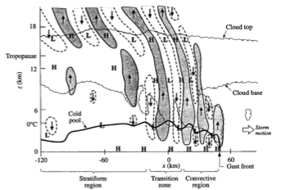
Gravity wave modulating weather systems and formation of new convective cells
May 2018
June 2020
Screenshots for two cases from NOAA CLIME app
Bore in squall line: fast propagation
Solitary GW in squall line: slow propagation
(Yang and Houze, 1995, MWR)
(Knupp, 2005, JAS)

Slide 10
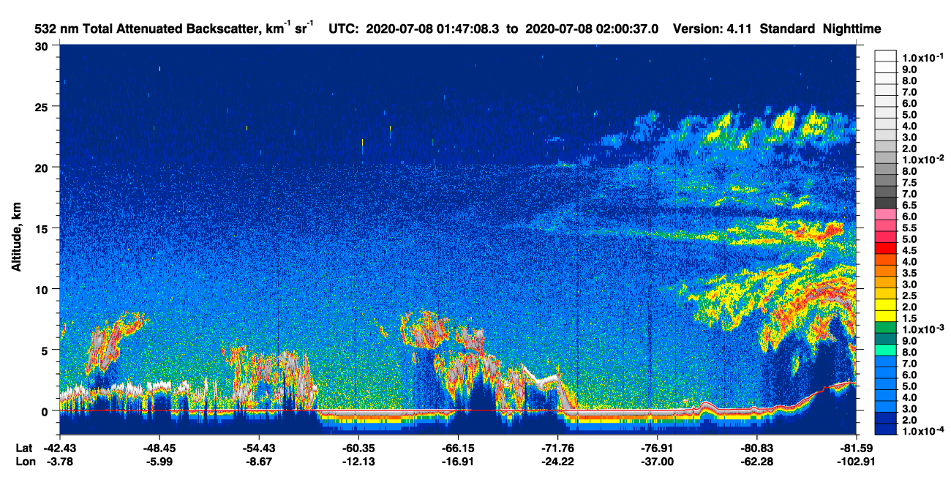
Winter polar stratospheric cloud (PSC) – catalyst for ozone depletion
CALIPSO lidar scan
https://www-calipso.larc.nasa.gov/data/BROWSE/production/V4-11/2020-07-08/2020-07-08_01-20-14_V4.11_3_1.png

Slide 11
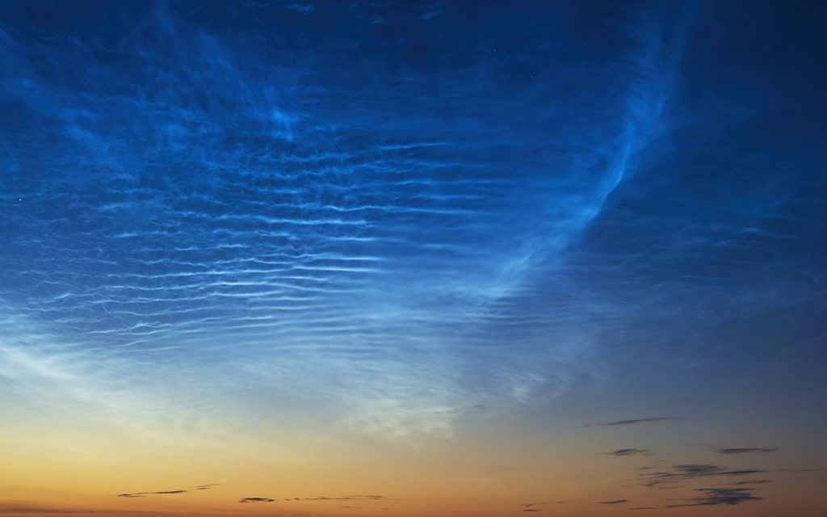
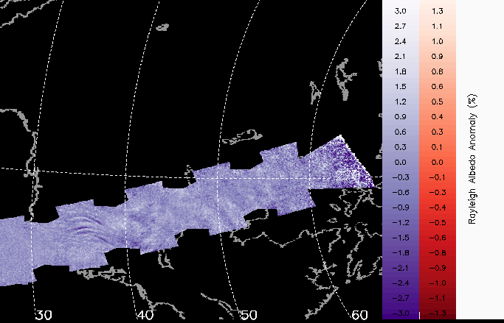
Summer polar mesospheric cloud (PMC) – atomic hydrogen or water vapor
CIPS Albedo
https://ece.vt.edu/research/annual-report/annual-report-2022/edge-of-clouds.html
Why do clouds form in winter polar stratosphere, but in summer polar mesosphere?
https://lasp.colorado.edu/aim/

Slide 12
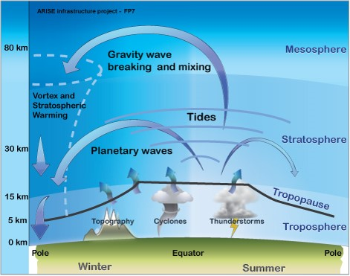
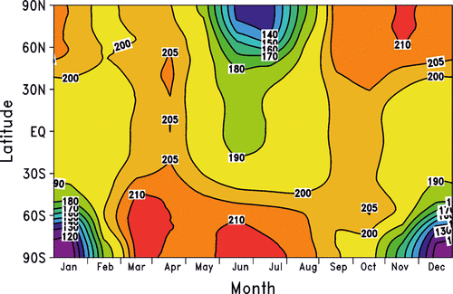
Mesosphere (87 km) temperature climatology
Summer pole is the coldest!
summer
winter
(Plane et al., 2015, Chem. Rev.)
https://lasp.colorado.edu/home/mag/research/middle-atmosphere-dynamics/

Slide 13
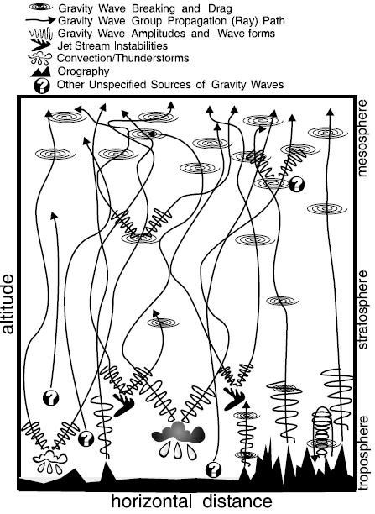
3. Major gravity wave sources
Gravity waves (GWs) serve as a critical mechanism for lower-upper atmosphere coupling through the vertical propagation and breaking
GWs contribute significantly in shaping the mesosphere circulation
Jet
Convection
Mountain
(Kim et al., 2003, Atm-Ocn.)

Slide 14
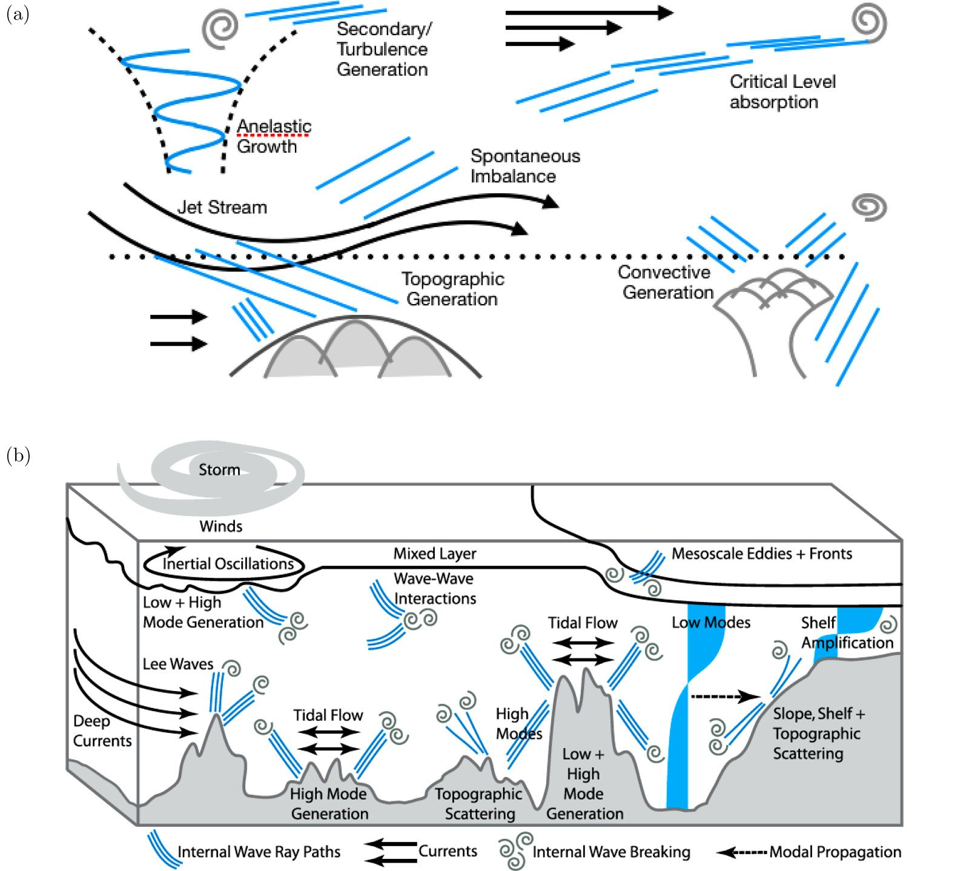
Atmosphere
Ocean
(Sutherland et al., 2019, Phys. Rev. Fluid)

Slide 15
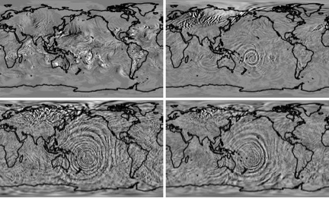
Z=11km
Z=30km
Z=87km
Z=100km
A WACCM-X simulation that illustrates how gravity waves were kicked off by a typhoon to the east of Australia build as they travel toward space (Liu et al., 2014, GRL).

Slide 16
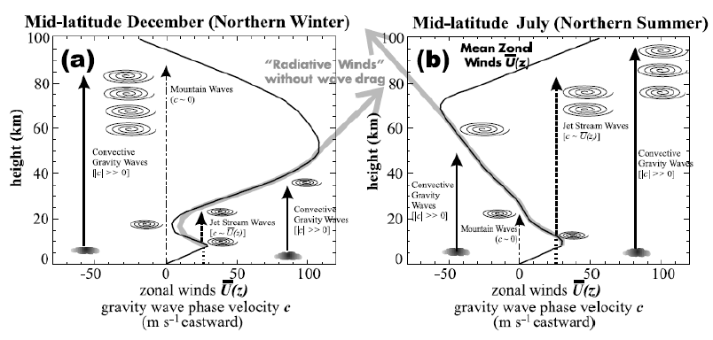

4. Gravity wave propagation
Gravity waves are drags to the mean flow
Gravity wave drags are currently partially parameterized in state-of-the-art GCMs, which are poorly constrained by observations.
Convection
Jet stream
Orography
(Kim et al., 2003, Atm-Ocn.)
$$\overline{p^{′}w′}=−\overline{U}\left(z\right)\left(\overline{u}−c\right)\overline{u^{′}w′}$$
Energy flux
Momentum flux
Break when phase speed equals background wind

Slide 17
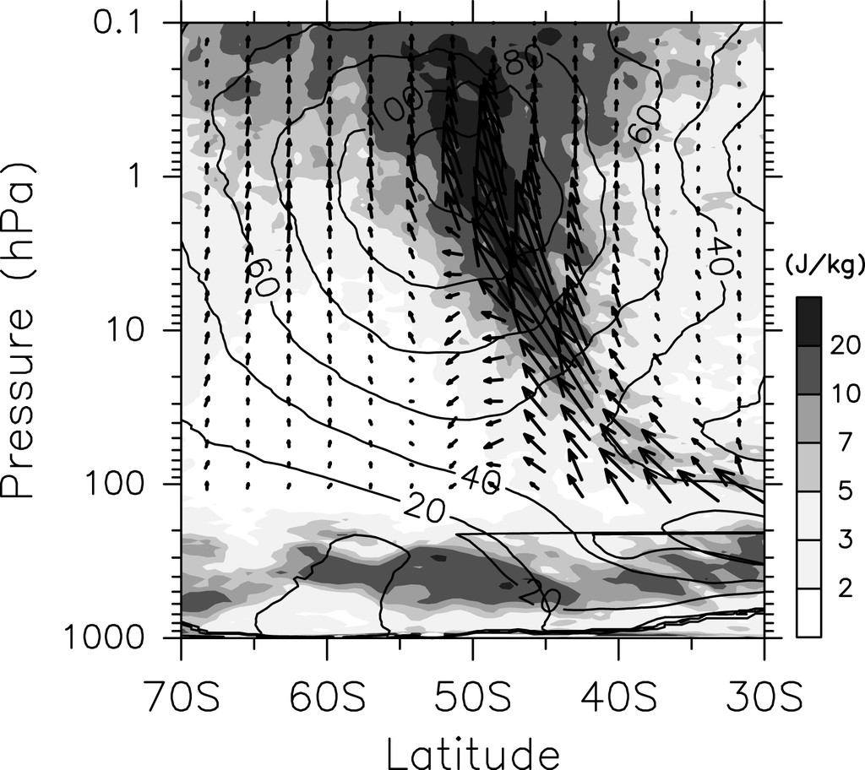
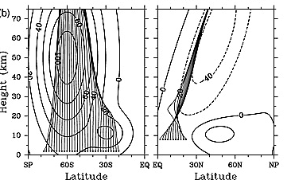
Gravity wave propagation is slantwise instead of vertical…
The resolved gravity wave energy flux also propagates into the jet core
With fixed background winds, gravity wave rays (think grey lines) tend to propagate into the jet core
(Sato et al., 2009, GRL)
(Sato et al., 2012, JAS)

Slide 18
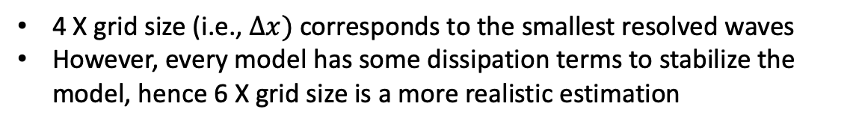

5. Modeling of gravity wave impact
Gravity wave wavelengths span a wide range:
  Horizontal wavelength: 10 – 1000s km
  Vertical wavelength: 0.1 – 10s km
Mesoscale or cloud-resolving model horizontal resolution: 3 – 30 km
Global model horizontal resolution: 10 – 250 km
Vertical grid: 100s m to 1-2 km
Rule of thumb for smallest resolvable waves: 6 X grid size, so small-scale gravity waves cannot be resolved and need to be parameterized
4 X grid size (i.e., $Δx)$ corresponds to the smallest resolved waves
However, every model has some dissipation terms to stabilize the model, hence 6 X grid size is a more realistic estimation
$$Δx$$
Open question for you: what is the largest wave that can be resolved?

Slide 19
What is model parameterization?
Small physical or chemical processes that cannot be resolved at model grid scale have to be parameterized.
Can you think of some physical processes that model probably cannot (fully) resolve and hence need to be parameterized?
  Turbulence processes
  Cloud microphysical processes (e.g., water vapor turn into droplet)
  Convective towers
  Cloud vertical distribution
  Aerosol-cloud interaction
  All chemical reactions
  Soil evaporation
  Gravity wave drag
  etc ….

Slide 20
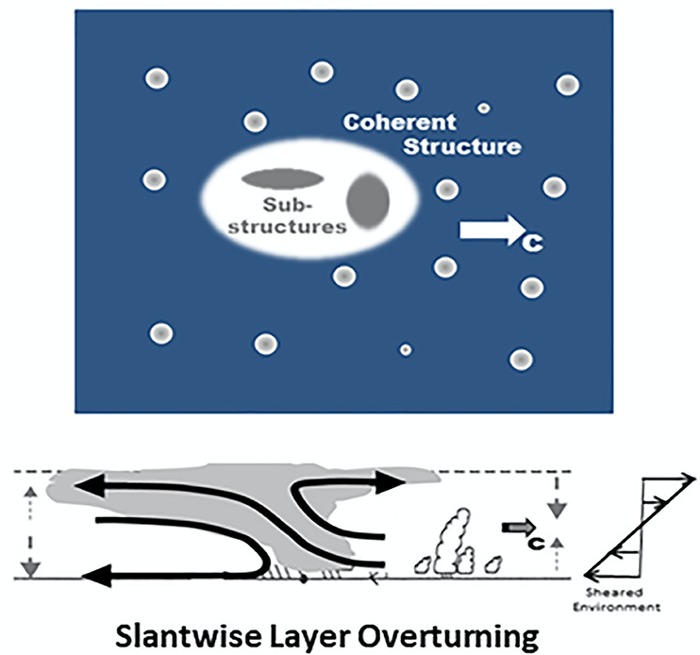
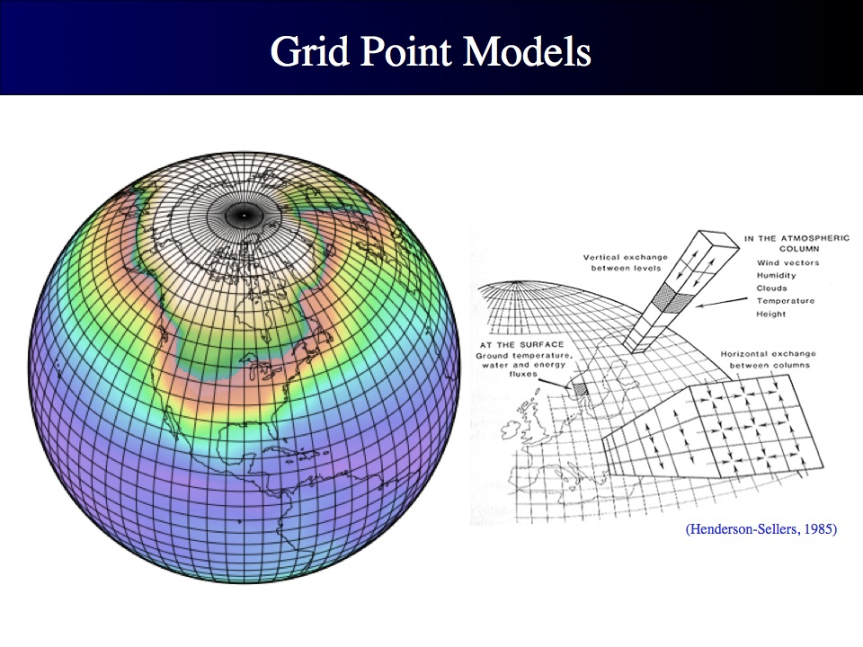
Challenge for gravity wave drag (GWD) parameterization
Slantwise propagation vs. column-wise simulation: we need accurate and fast cross-grid talk to enable slantwise GW propagation
Some GWD sources are also sub-grid scale, e.g., deep convection, topography
Wave intermittency is a heavily tuned parameter
Possible solution: ray-based parameterization
(Moncrieff, 2019, GRL)
https://serc.carleton.edu/eet/envisioningclimatechange/part_2.html

Slide 21
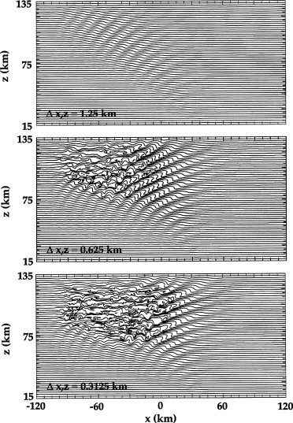
Challenge for GWD parameterization (cont’d)
Ever-changing model grids vs. ever-tuning GWD parameters
Possible approaches proposed in recent year: self-adaptive parameterization schemes; machine learning-based parameterization, etc.
Vertical wavelength
Resolved
Decrease of grid size
It’s soon a chaos when you let all kinds of waves propagate freely in the model!
Unresolved
Horizontal wavelength
(Prusa et al., 2008, Comp. & Fluid)
Secondary GW generation at the mesopause is a key mechanism for upper atmosphere coupling, but is merely considered in climate models.

Slide 22
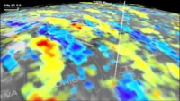
In the next class, we will see how we observe atmospheric gravity waves using satellite, radiosonde, etc., in the context of solar eclipse…
Let’s end this class with a spoiler video
A tornado gravity wave case that I studied with my colleagues
(If video doesn’t work, click the link: https://www.youtube.com/watch?v=2SfHs3O8Y7M )

Slide 23
References
Geldenhuys (2022), A. S. L., 10.1002/asl.1084
Kim et al. (2003), Atm. Ocn., 10.3137/ao.410105
Lastovicka et al. (2006), Science, DOI: 10.1126/science.1135134
Liu et al. (2014), GRL, 10.1002/2014GL062468
Moncrieff (2019), GRL, 10.1029/2019GL085316
Plane et al. (2015), Chem. Rev., doi:10.1021/cr500501m
Prusa et al. (2008), Comp. and Fluid, doi:10.1016/j.compfluid.2007.12.001
Sutherland et al. (2019), Phys. Rev. Fluid, doi:10.1103/PhysRevFluids.4.010501
Sato et al. (2009), GRL, doi:10.1029/2009GL039908
Sato et al. (2012), JAS, doi:10.1175/JAS-D-11-0101.1
Yang and Houze (1995), MWR, doi:10.1175/1520-0493(1995)123<0641:MSLSAA>2.0.CO;2

Slide 24
Homework sample questions
When a rising balloon passes through a gravity wave front, which way do you think its trajectory will look like?
  (A) up-down oscillation (B) slantwise oscillation (C) spiral oscillation
The vertical oscillation component of gravity wave originates from a balance between gravity and buoyancy. What forces balance on the horizontal direction?
Can you name a few atmospheric gravity wave sources? Can you name a few oceanic gravity wave sources?
Can you lay-out a few reasons why gravity waves are important, so we need to study them?
Can you lay-out a few challenges for models to simulate gravity wave impacts?
Can you think of some processes that a typical climate model cannot resolve other than the ones listed in the slides?
Given a global climate model (GCM) grid size of 100 km, and the earth radius of 6371 km, theoretically what are the smallest and largest wavelength of waves that this GCM can resolve?

Slide 25
Sample homework answer key
C
We only need Coriolis force for the horizontal oscillation. Remember Coriolis force is always to the right in the Northern hemisphere and to the left in the Southern hemisphere of the moving direction, so itself forms the so-called inertial oscillation. You can see marine debris often gradually aggregate together into big piles. That’s not only because they follow the general ocean current, but also the inertial motion looping in smaller areas at the same time.
Atmosphere: mountain/topography, deep convection (including typhoon, hurricane, tornado), jet, frontal system, solar eclipse (yes, that’s one of the major drives of this campaign!), volcano eruption, tsunami, missile launch, rocket launch, …
Ocean: ocean surface topography, wind blowing at the ocean surface (e.g., by storms, hurricane, etc.), tsunami, underwater volcano eruption, torpedo, throwing a rock into water, tides, …

Slide 26
Sample homework answer key (cont’d)
(1) Gravity waves in the troposphere impact weather. They often play a role in modulating the formation of new convective cells and the propagation of the convective system. They are often associated with hazardous aviation scenarios like triggering clear-air turbulence, forming dangerous downdraft flow or forming cloud bands. (2) They serve as a key mechanism for the lower-upper atmosphere coupling because they transport energy and momentum from the source to the sink. (3) They perturb the temperature (and hence relative humidity or other chemical reactions that are sensitive to temperature) in the stratosphere and mesosphere, which serves as an important mechanism for the formation of PSCs and PMCs, both have strong climate impact (e.g., worsen ozone depletion). (4) gravity waves in the thermosphere and ionosphere are coupled with other variations, e.g., tides, magnetic storm, and impact communication, space weather and spacecraft operations.
The major challenge is that none of the model can resolve all gravity waves. Ultra-high resolution is rather a curse than a bless for resolving gravity waves as they cause instability and chaos. Modelers strive to parameterize the impact from unresolved waves, while making sure the resolved waves are reasonable and do not breakdown other things. (See slide 19 & 20 for more complete answers)
Open answer. Any processes that are smaller than ~ 100 km scale, or very fast/transient or very slow, but in the meantime are important to weather prediction or climate projection.
Smallest wave = 4 X grid size = 400 km (again, in reality 600 km is a more practical answer. Both correct)
Largest wave = Earth’s circumference / 4 = 2* pi * radius / 4 ~ 10, 000 km

